Slide 1

Aquafy Systems Retro-Fittable Multi-Stage filtration with Auto-Cleaning and IOT for efficient greywater treatment and reuse.

Slide 2


The Problem
1
Expensive and Space-Intensive
Current technologies are expensive, land-intensive, and impractical for widespread or decentralized use.
Problem: Water scarcity and contamination in India
2
Lack of Monitoring and Maintenance
Size of Market:
Total Market size- 15-20 Million Units over the next 5-10 years
Existing wastewater treatment systems often lack proper monitoring and maintenance
Urban Households
Commercial & Institutional buildings
Commercial, Institutional buildings
Unaffordable Compact Systems
10-15 Million Households
3
50K-75K establishments
Even the most space-saving treatment systems are often too expensive for small-scale applications and individual households.
Urban areas with water scarcity
Hotels, Malls, Hospitals, Schools, Restaurants
Real Estate projects
Water intensive industries
Limited Water Reclamation
800-1500 residential projects annually
10k industrial units
4
The use of reclaimed water is minimal due to a lack of affordable solutions, leading to reliance on fresh water for non-potable uses.
Gated communities, apartments, smart cities
Textile, food processing, Pharmaceutical industries
Govt. & Smart cities
Rural Areas and Agriculture
Need for Innovation
100+ smart cities & Govt. establishments
5
Water scarce regions e.g. Rajasthan, Gujarat
There is an urgent need for innovative, affordable, and scalable solutions to tackle these challenges, particularly in resource-limited settings.
Public parks, road cleaning
Non-potable uses e.g. irrigation, toilet flushing

Slide 3
Target Market & Opportunity:
User segment
Geographical Region
Idea of potential market size
The geographical regions most likely to benefit from our treatment solution:-
Rajasthan: Facing extreme water scarcity and reliance on depleting groundwater resources.
Maharashtra: Urban water stress in Mumbai and Pune, coupled with drought-prone rural areas.
Tamil Nadu: Cities like Chennai frequently experience water crises due to erratic rainfall and over-exploitation of groundwater.
Karnataka: Bangalore and northern districts face urban water stress and frequent droughts.-
Delhi NCR: Severe water pollution and shortage in a densely populated urban area.
Gujarat: Drought-prone state with rapid industrialization contributing to water stress.
Punjab and Haryana: Agricultural areas facing groundwater depletion and pollution due to over-extraction and fertilizer use.
1. Urban Households:
1. Urban Households
100 million households in India.
10-15% adoption = 10-15 million units.
Target- 10-15 Million household in water-scares urban areas
2. Commercial Buildings
2. Commercial Buildings:
Hotels, restaurants, Shopping malls where there is significant water loss
750,000 restaurants.
100,000 hotels.
2,000 malls.
5-10% adoption = 50,000-75,000 units.
3. Water-intensive industries
Sectors like textile, food processing and pharmaceuticals
3. Water-Intensive Industries:
4. Real-estate projects
100,000 industrial units.
10% adoption = 10,000 units.
Residential complexes and smart city development
4. Real Estate Projects:
8,000-10,000 projects annually.
10-15% adoption = 800-1,500 projects annually.
5. Rural communities and School
Limited water resources in rural areas. Target: Rural schools and farms.
5. Rural Communities & Schools:
6. Government Institutions:
1.2 million rural schools.
Focus on water-scarce areas for potential adoption.
Public buildings and community centers. Focus on water conservation initiatives.
7. Agricultural Sector:
Total Market Potential: Estimated 15-20 million units.
Market Value: INR 40,000-50,000 crores (~$5-6 billion USD) over 5-10 years
Farmers needing irrigation solutions. Target: Areas facing significant water scarcity.

Slide 4
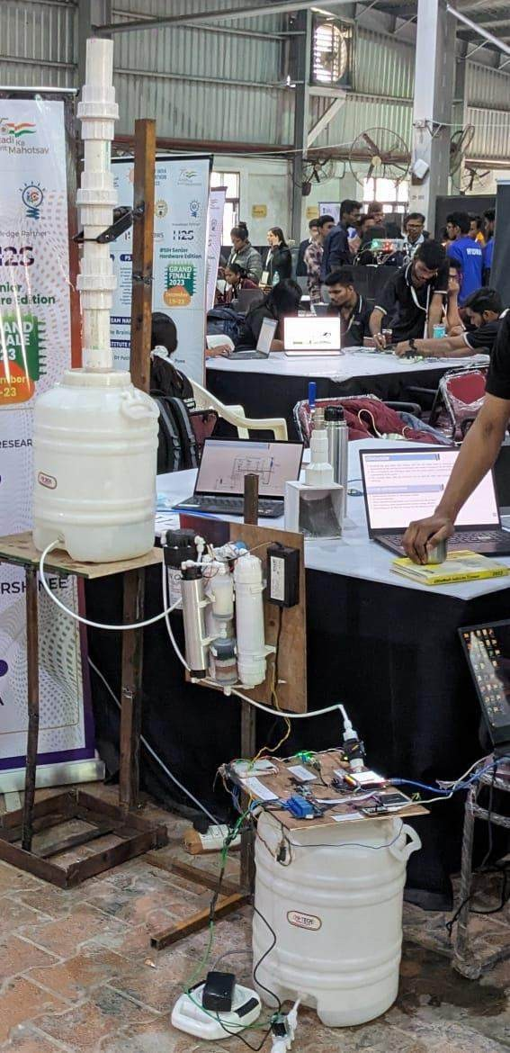
Filtration Unit System

Slide 5
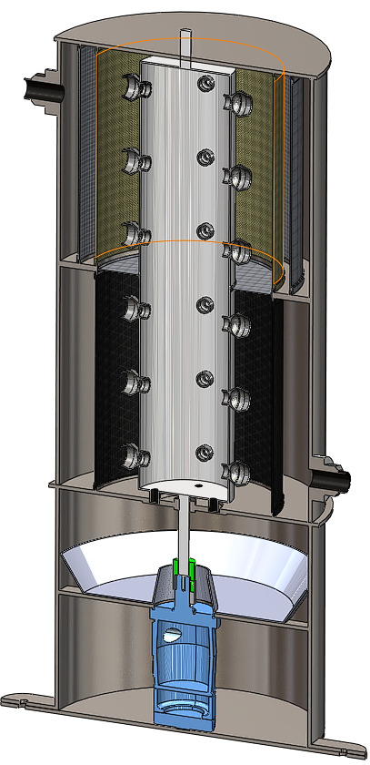
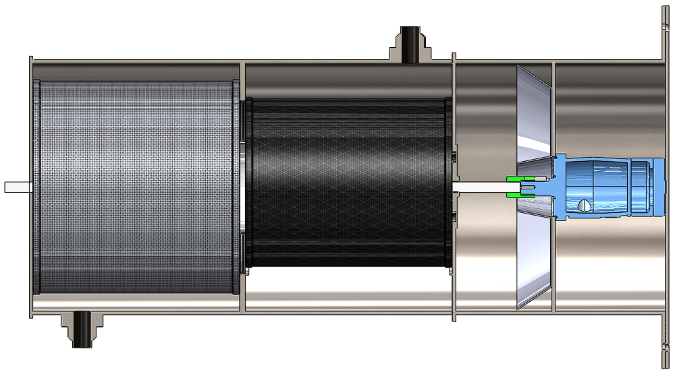
Inlet
Coarse screen 1 (CS1)
Coarse screen 2 (CS2)
Dirt collection rod
Fine screen
Jet valve
outlet
Hydraulic motor
Piston
Fig- 3D structure of hydrasweep self-cleaning multiscreen chamber

Slide 6
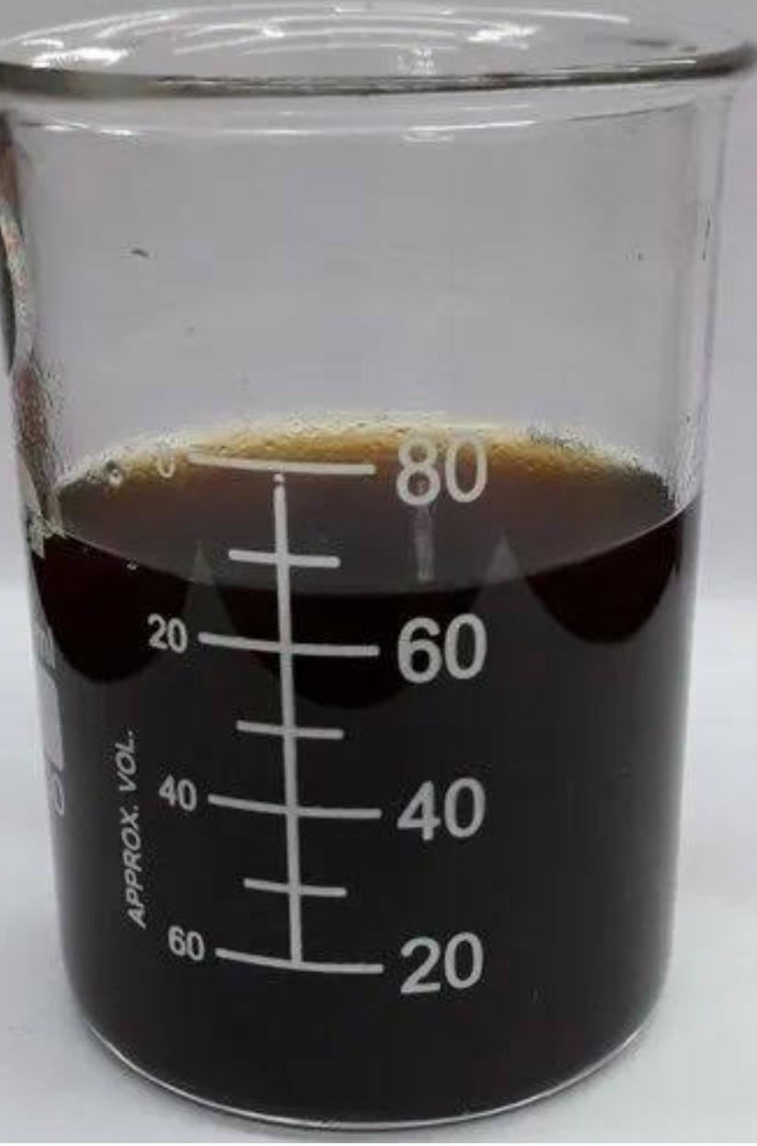
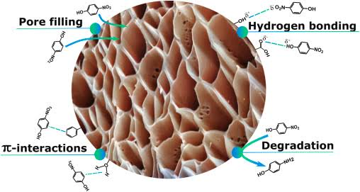
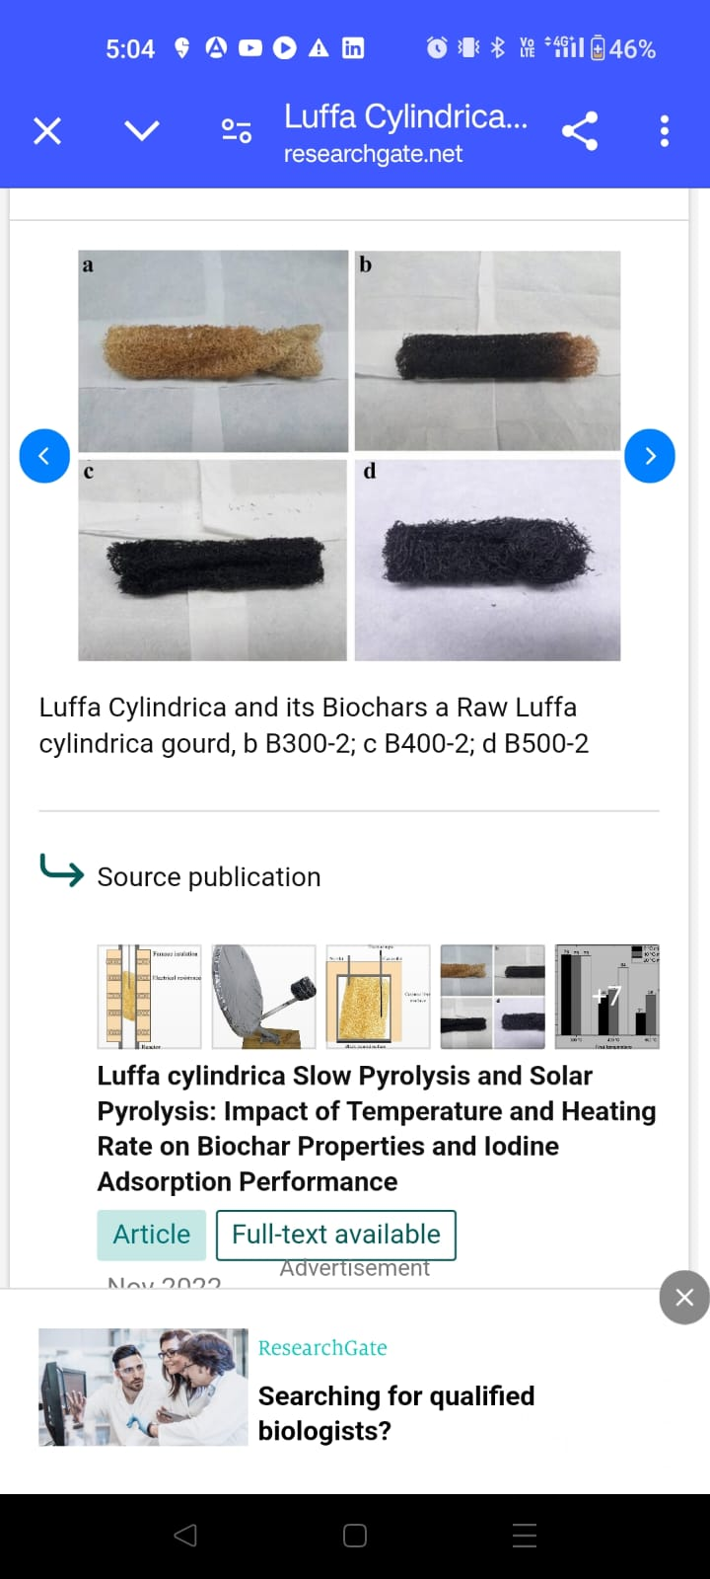
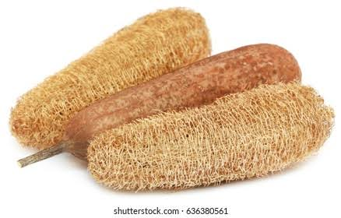
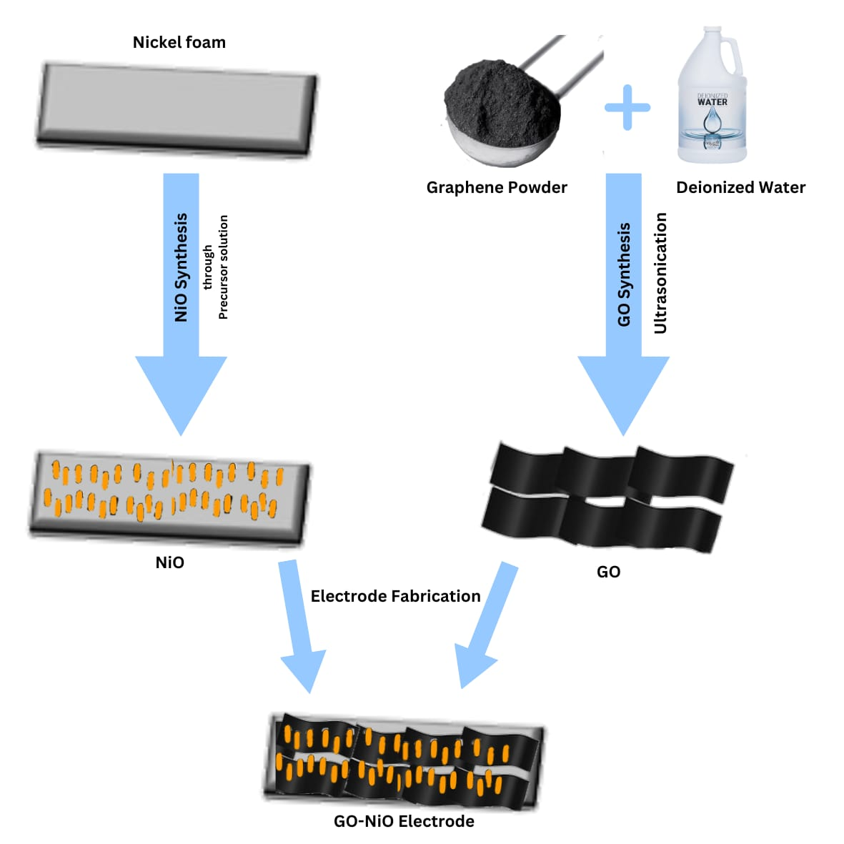
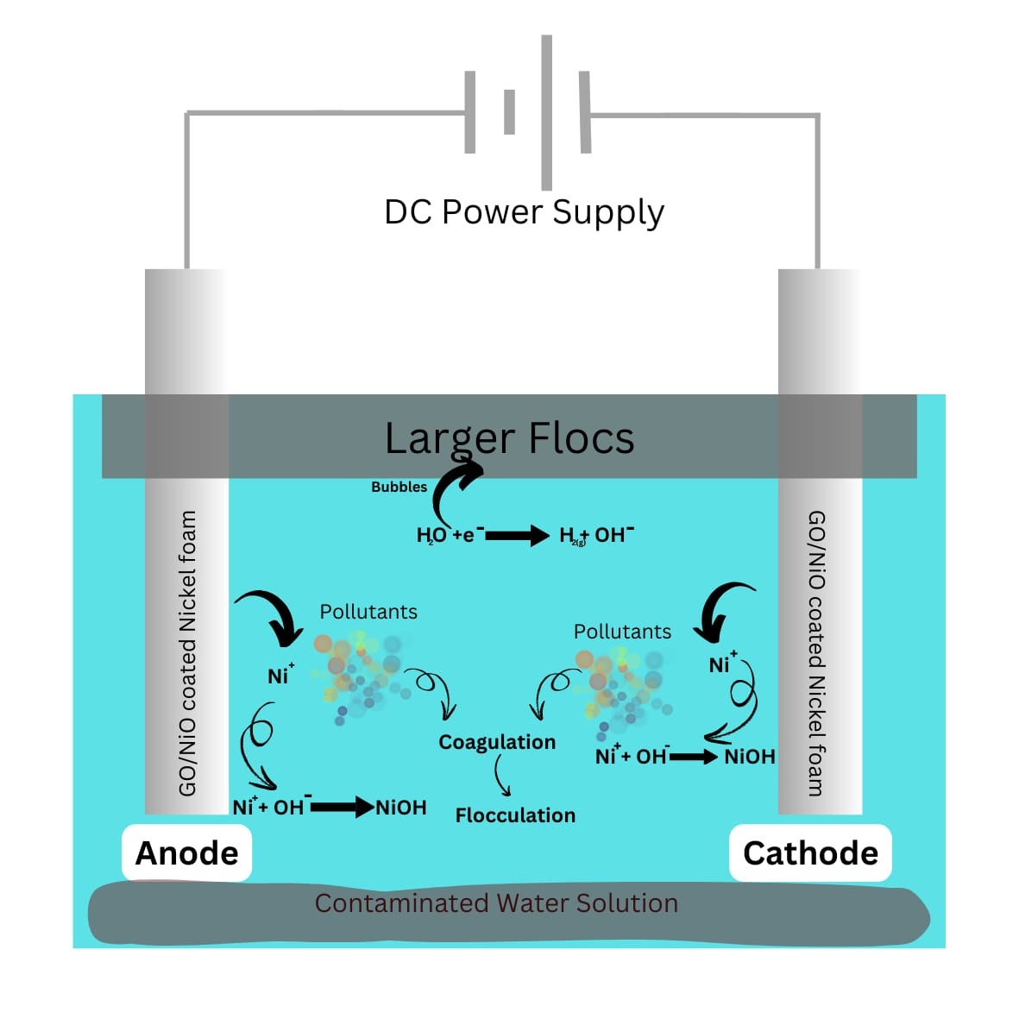
Adsorption
4
Nitrogen Doping of GO
5
Titanium Oxide doping
Collection, cleaning and drying of Luffa
Pyrolysis to form Luffa-derived biochar
Preparation of Graphene Oxide (GO)
6
Combination of Nitrogen and Titanium Oxide doped GO with Luffa-derived biochar
Drying, Calcination, Final product formation
1
2
3
7
Electrocoagulation

Slide 7

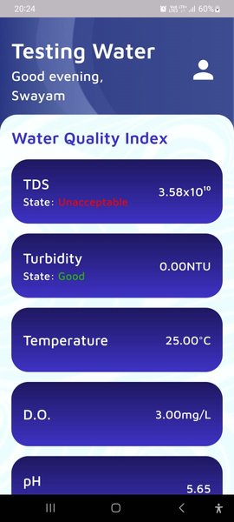
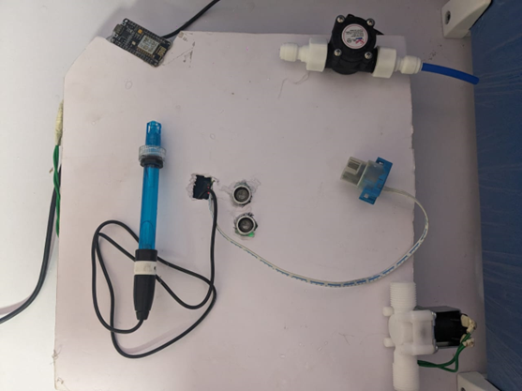
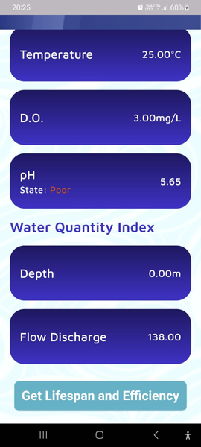
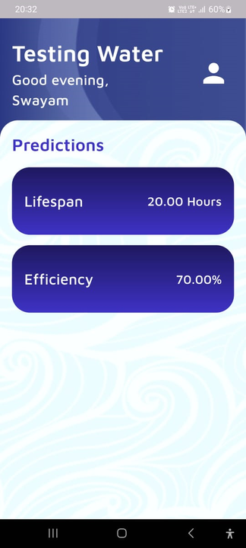
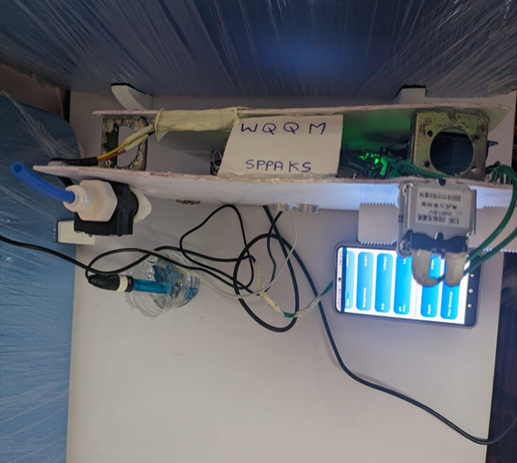
Real Time Data / ML integrated
IOT (WQQM) unit
AquafySystem App
Inflow of Water
Turbidity Sensor
Esp 32 WIFI Module
Arduino Mega Microcontroller
Ph Sensor
Solenoid Valve
Relay Module (for Valve Control water flow
Ultrasonic Sensor
Ph testing
Aquafysystems APP (Real Time notification data )
Flow Sensor

Slide 8
Additional Work Yet To Be Undertaken (2 Months Plan)
Hydra Sweep Self-Cleaning Multiscreening Chamber (Piston mechanism)
Design and develop the piston mechanism for the HydraSweep system.
Ensure self-cleaning functionality and test the removal efficiency.
Ceramic Filter preparation and Polymer Coating
Fabricate ceramic filters and apply a polymer coating & acoustic technology to enhance filtration performance.
Test for improved durability and resistance to biofouling.
Conduct XRD (X-ray Diffraction), SEM (Scanning Electron Microscopy), and TEM (Transmission Electron Microscopy) analyses to understand the filter's microstructure and elemental composition..
Measure the lifespan and clogging potential of the biochar filter.
Biochar Filter Efficiency testing
Nickel Foam Electrode for Electrocoagulation
Simulate the removal efficiency of the electrode to optimize its performance.

Slide 9
Test the integrated unit, including the multiscreening chamber, ceramic filter, biochar filter, and electrocoagulation components.
Analyze removal efficiency and water quality improvements.
Overall System Testing
test the effectiveness of the smart water quality and quantity monitoring system. Analyze removal efficiency and water quality improvements.
Use machine learning to predict filter lifespan and optimize maintenance schedules based on water quality data.
Smart Water Quality and Quantity Monitoring
Compile all system components into a basic working prototype. Analyze removal efficiency and water quality improvements.
Evaluate the prototype's overall performance, including filtration efficiency and system automation.
Basic Design Prototype

Slide 10
Challenges Faced
Lab facility to develop fully furnished product.
Access to instruments for model preparation and testing.
Access to Advanced Machine Learning Tools
Sensor Accuracy and Calibration
Limited Testing Environment
Budget Limitations for Procuring filtration unit and IoT Devices

Slide 11
References
Code link - GitHub ML IOT- https://github.com/Saraswat123/AquafySystems-SIH-
Drive Link- https://drive.google.com/drive/folders/1cYz5h2USBBb2kYatrITE1QJP1x2emAlz

Slide 12
References
[1] Census of India. (2011). Census Data 2011. Government of India. Link to Census of India. (Link)
[2] NITI Aayog. (2019). Composite Water Management Index. Government of India. Link to NITI Aayog Report. (Link)
[3] Federation of Hotel & Restaurant Associations of India (FHRAI). (2020). Indian Hotel Industry Overview. (Link)
[4] Shopping Centres Association of India (SCAI). (2021). Shopping Malls in India: Growth and Opportunities. (Link)
[5] Ministry of Water Resources, Government of India. (2020). National Water Policy. (Link)
[6] FICCI. (2019). Water: The Looming Crisis for Indian Industry. Federation of Indian Chambers of Commerce & Industry.(Link)
[7] National Real Estate Development Council (NAREDCO). (2021). Real Estate Sector in India: An Overview (Link)
[8] National Statistical Office (NSO). (2020). Statistical Yearbook of India. Government of India. (Link)

Slide 13
[9] Ministry of Rural Development, Government of India. (2020). Rural Development Statistics. (Link)
[10] Ministry of Agriculture, Government of India. (2021). Agricultural Statistics at a Glance. (Link)
[11] Market Research Reports. (2023). Greywater Treatment Market in India: Trends and Opportunities. Various Industry Reports. (Link)
[12]Titanium Dioxide/N-Doped Graphene Composites as Non-Noble ... https://pubs.acs.org/doi/full/10.1021/acs.iecr.1c02896-
[13] Tuning the type of nitrogen on N-RGO supported on N-TiO2 under ...
https://www.sciencedirect.com/science/article/pii/S1350417719314269-
[14] Titanium Dioxide (B)/ Silicon Composite Prepared by Dispersion ...
https://www.researchgate.net/ publication/340623930_
[15]Nanostructural_Characterization_of_NitrogenDoped_Graphene_Titanium_Dioxide_B_Silicon_Composite_Prepared_by_Dispersion_Method- Preparation of Nitrogen‐Doped Mesoporous TiO2/RGO Composites ...
https://onlinelibrary.wiley.com/doi/10.1155/2019/6467107-

Slide 14
[14] Effect of Nitrogen Doping on the Optical Bandgap and Electrical
https://www.ncbi.nlm.nih.gov/pmc/articles/PMC8588234/-
[15] influence of nitrogen doping on reduced graphene oxide as ...
https://www.sciencedirect.com/science/article/abs/pii/S0360319921001944-
[16] Improved output performance of hybrid composite films with nitrogen ...
https://www.sciencedirect.com/science/article/abs/pii/S0272884221040669-
[17] Simultaneous Nitrogen Doping and Reduction of Graphene Oxide
https://pubs.acs.org/doi/10.1021/ja907098f-
[18] Porous nitrogen-doped reduced graphene oxide-supported CuO
[19] Nitrogen-doped reduced graphene oxide-polyaniline composite ...
https://pubs.rsc.org/en/content/articlelanding/2023/nj/d2nj05112e-
[20] Nitrogen-Doped Reduced Graphene Oxide Prepared by ...
https://pubs.acs.org/doi/abs/10.1021/acsami.5b07757-

Slide 15
[21] Nitrogen-doped graphene: Synthesis, characterizations and energy ...
https://www.sciencedirect.com/science/article/abs/pii/S2095495617310616-
[22] [PDF] Nitrogen-doped graphene and its electrochemical applications†
https://www.princeton.edu/~cml/assets/pdf/pu_10_20shao.pdf-
[23] Nitrogen-doped graphene oxide with enhanced bioelectricity ...
https://www.sciencedirect.com/science/article/abs/pii/S0959652622036435-
[24] [PDF] Nitrogen-doped graphene nanomaterials for electrochemical ..
https://www.osti.gov/servlets/purl/1981552
[25] Reduced Graphene Oxide Hydrogels Deposited in Nickel Foam for ...
https://pubs.acs.org/doi/abs/10.1021/acs.jpcc.6b00326-
[26] Fig. S1 (a) Digital photographs of nickel foam, GO deposited in nickel..
https://www.researchgate.net/figure/Fig-S1-a-Digital-photographs-of-nickel-foam-GOdeposited-in-nickel-foam-N-rGONF_fig1_270288410-
[27] am-GOdeposited-in-nickel-foam-N-rGONF_fig1_270288410- Porous Graphene Oxide Prepared on Nickel Foam by ... – MDPI
https://www.mdpi.com/1996-1944/10/8/936

